Slide 1
PPE Compliance Check
Eva Abou Harb Project Tier: 2
Mary Ann Mastri
Zain Ahmed

Slide 2
The Problem
What real-world problem are we solving?
- Workers in industrial settings do not always wear the required personal protective equipment (PPE), increasing the risk of workplace injuries.
Why is it important?
- Reduce workplace accidents
- Improve safety compliance
- Lower financial and legal risks
Who cares?
- Construction companies
- Safety managers
- Manufacturing facilities
- OSHA inspectors

Slide 3

Our Solution
What will our system do?
- Detect workers and PPE in images
- Identify helmets, safety vests, and goggles
- Determine whether each worker is compliant
How will it solve the problem?
Image → YOLO11 → Detect PPE → Compliance Check
📷 → 🤖 → 🦺 → ✅
One-sentence description
An AI-powered system that automatically detects whether construction workers are wearing the required PPE using YOLO11 object detection.

Slide 4
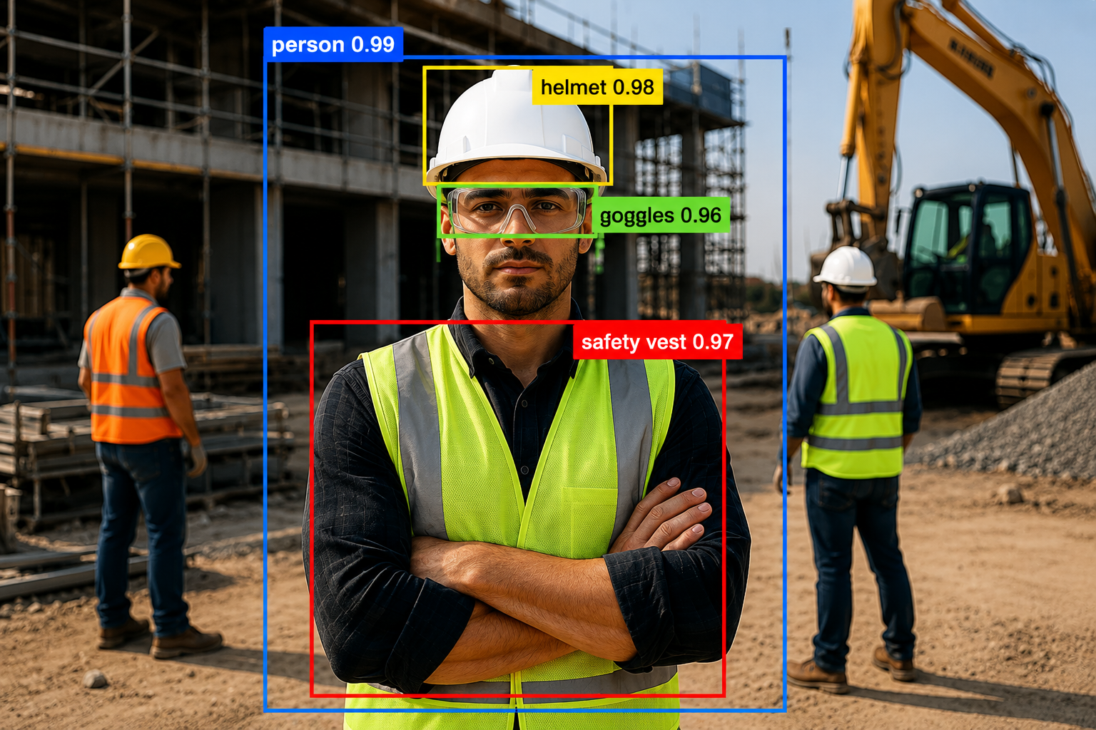
Technical Approach
Computer Vision Technique: Object Detection
Model: YOLO11
Framework: PyTorch/Ultralytics
Dataset: Roboflow + Kaggle
YOLO11 was selected because it provides fast and accurate real-time object detection, making it ideal for PPE detection in construction environments. PyTorch and Ultralytics provide an efficient framework for training, evaluating, and deploying the model.

Slide 5
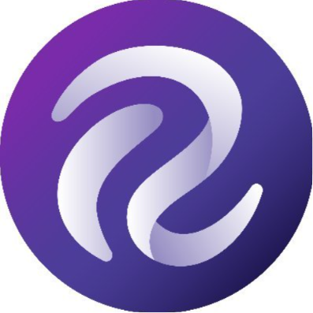
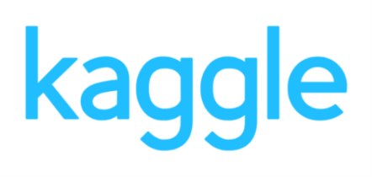
Data Plan
Source:
Roboflow Universe
Kaggle PPE Datasets
Dataset Size:
Roboflow dataset: 136 labeled images
Labels:
Person
Hard Hat
Safety Vest
Safety Goggles
Data Preparation:
Verify annotations
Resize images
Data augmentation
Train / Validation / Test split
Kaggle dataset: 7,035 images

Slide 6
System Diagram
📷 Step 1 – Image Acquisition
Capture or upload an image of workers at a construction site.
🧠 Step 2 – Model Inference
YOLO11 processes the image and detects workers and PPE.
🦺 Step 3 – PPE Detection
Identify helmets, safety vests, and safety goggles.
✅ Step 4 – Compliance Decision
Determine whether each worker is compliant or non-compliant.
📊 Step 5 – Output & Visualization
Display detection results with bounding boxes, labels, and compliance status.

Slide 7

Success Metrics
Metric Type | Example | Target
Primary Metric | Accuracy, Precision, Recall | ≥ 90% overall accuracy
Secondary Metric | Inference Speed (Latency) | < 1s per image

Slide 8
Week-by-Week Plan
Task | Milestone
Get dataset & set up environment | ✅Dataset Ready
Train or fine-tune model | 🤖Model Working
Test and improve | 📈Good Accuracy
Create demo or video | 🎥Demo Ready
Final testing & documentation | 📄Everything Done
Present project | 🎉Presentation Day

Slide 9
Challenges & Backup Plans
⚠️ Challenge | 🛠️ Plan B
Limited training data | Use additional Roboflow and Kaggle datasets.
Model accuracy below 90% | Apply data augmentation or use a larger YOLO11 model.
Poor lighting or image quality | Collect more diverse images and improve preprocessing.
Small or partially hidden PPE | Fine-tune the model with additional labeled images.

Slide 10
Resources Needed
Resource | Options / Notes
Compute | Google Colab, Kaggle
Frameworks | PyTorch, Ultralytics
Dataset Sources | Roboflow, Kaggle
Development Tools | Python, Jupyter Notebook
Estimated Cost | $0 (using free educational resources)

